Slide 1

CAP-788 DATA SCIENCE TOOLBOX LAB (CA-1)
SUBMITTED TO:
Dr. APASH ROY
(23550)
SUBMITTED BY:
YASH AGARWAL
MCA-DE566
RDE566A03
12000323

Slide 2
SET-A
Make a tutorial presentation/ documentation on R programming Basics- Introduction, Syntax, Comments, Variable, Data Type, Number, math, String, Logical/Boolean. Write programming example for each of them. (Use Screenshots of full screen for each step, so that it can be differentiated from other person) .

Slide 3

INTRODUCTION:
R is a language and environment for statistical computing and graphics.
It is a GNU project which was developed at Bell by John Chambers and colleagues.
R can be considered as a different implementation of S.
R offers a huge type of statistical and graphical techniques, and is exceptionally extensible.

Slide 4
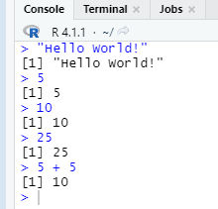
SYNTAX:
To output text in R, use single or double quotes:
"Hello World!"
5
10
25
5 + 5

Slide 5
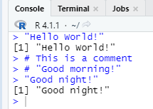
COMMENTS:
Comments can be used to explain R code, and to make it more readable. It can also be used to prevent execution when testing alternative code.
"Hello World!" # This is a comment
# "Good morning!" "Good night!"

Slide 6
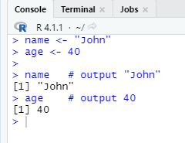
VARIABLES:
Variables are containers for storing data values.
name <- "John" age <- 40 name # output "John" age # output 40

Slide 7
DATA TYPE’s:
In programming, data type is an important concept.
Variables can store data of different types, and different types can do different things.
DATA TYPE | RANGE
Numeric Integer Complex (a.k.a. String) Character Logical (a.k.a. Boolean) | (10.5, 55, 787) (1L, 55L, 100L, where the letter "L" declares this as an integer) (9 + 3i, where "i" is the imaginary part) ("k", "R is exciting", "FALSE", "11.5") (TRUE or FALSE)

Slide 8
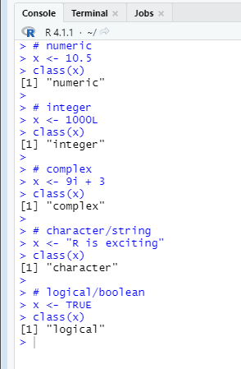
DATA TYPE’s (Cont.):
# numeric x <- 10.5 class(x)
# integer x <- 1000L class(x)
# complex x <- 9i + 3 class(x)
#character/String x <- "R is exciting" class(x)
# logical/Boolean x <- TRUE class(x)

Slide 9
NUMBER:
There are three number types in R:
Numeric
Integer
Complex
x <- 10.5 # numeric y <- 10L # integer z <- 1i # complex

Slide 10
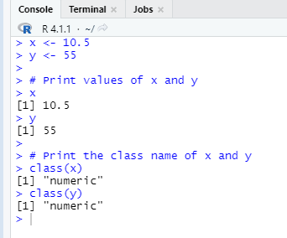
NUMERIC:
A numeric data type is the most common type in R, and contains any number with or without a decimal, like: 10.5, 55, 787
x <- 10.5 y <- 55
# Print values of x and y x y # Print the class name of x and y class(x) class(y)

Slide 11

INTEGER:
Integers are numeric data without decimals. This is used when you are certain that you will never create a variable that should contain decimals. To create an integer variable, you must use the letter L after the integer value.
x <- 1000L y <- 55L # Print values of x and y x y # Print the class name of x and y class(x) class(y)

Slide 12

COMPLEX:
A complex number is written with an "i" as the imaginary part.
x <- 3+5i y <- 5i # Print values of x and y x y # Print the class name of x and y class(x) class(y)

Slide 13
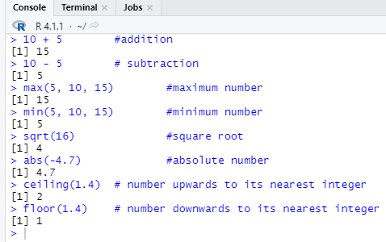
MATH:
In R, you can use operators to perform common mathematical operations on numbers.
10 + 5 #addition
10 - 5 # subtraction
max(5, 10, 15) #maximum number min(5, 10, 15) #minimum number
sqrt(16) #square root
abs(-4.7) #absolute number
ceiling(1.4) # number upwards to its nearest integer floor(1.4) # number downwards to its nearest integer

Slide 14
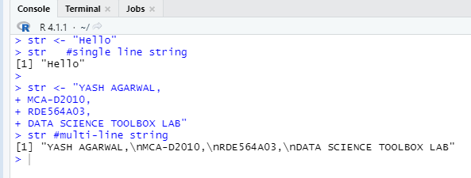
STRING:
A character, or strings, are used for storing text. A string is surrounded by either single quotation marks, or double quotation marks.
str <- "Hello" str #single line string
str <- "YASH AGARWAL,
MCA-D2010,
RDE564A03,
DATA SCIENCE TOOLBOX LAB"
str #multi-line string

Slide 15
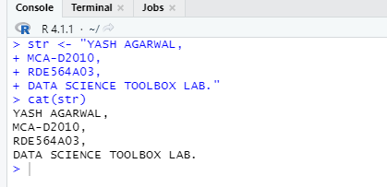
STRING (cont.):
str <- "YASH AGARWAL,
MCA-D2010,
RDE564A03,
DATA SCIENCE TOOLBOX LAB."
cat(str)

Slide 16
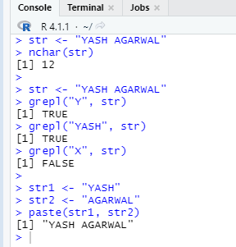
STRING (cont.):
str <- "YASH AGARWAL"
nchar(str)
str <- "YASH AGARWAL"
grepl("Y", str)
grepl("YASH", str)
grepl("X", str)
str1 <- "YASH"
str2 <- "AGARWAL"
paste(str1, str2)

Slide 17
STRING (cont.):
Code | Result
\\ | Backslash
\n | New Line
\r | Carriage Return
\t | Tab
\b | Backspace

Slide 18
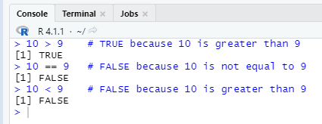
LOGICAL/BOOLEAN:
You can evaluate any expression in R, and get one of two answers, TRUE or FALSE
10 > 9 # TRUE because 10 is greater than 9 10 == 9 # FALSE because 10 is not equal to 9 10 < 9 # FALSE because 10 is greater than 9

Slide 19
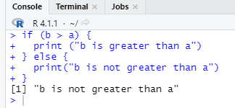
LOGICAL/BOOLEAN:
a <- 200 b <- 33 if (b > a) { print ("b is greater than a") } else { print("b is not greater than a") }

Slide 20


